Slide 1

Multi-Functional educational webapp
Team BugZero
Team Members-
Aarushi Sharma
Prachi Singh
K.Kirti

Slide 2
ABOUT US !
E-pathshala educational services Ltd. is an Indian educational technology (EdTech) and online tutoring webapp
1. You can choose courses of your choice at free or buy one!
2. Test yourself with our quizzes and assessments
3. Have a doubt? Clarify with a mentor or just chat right away!
4. Also win points for performing exceptionally well!

Slide 3
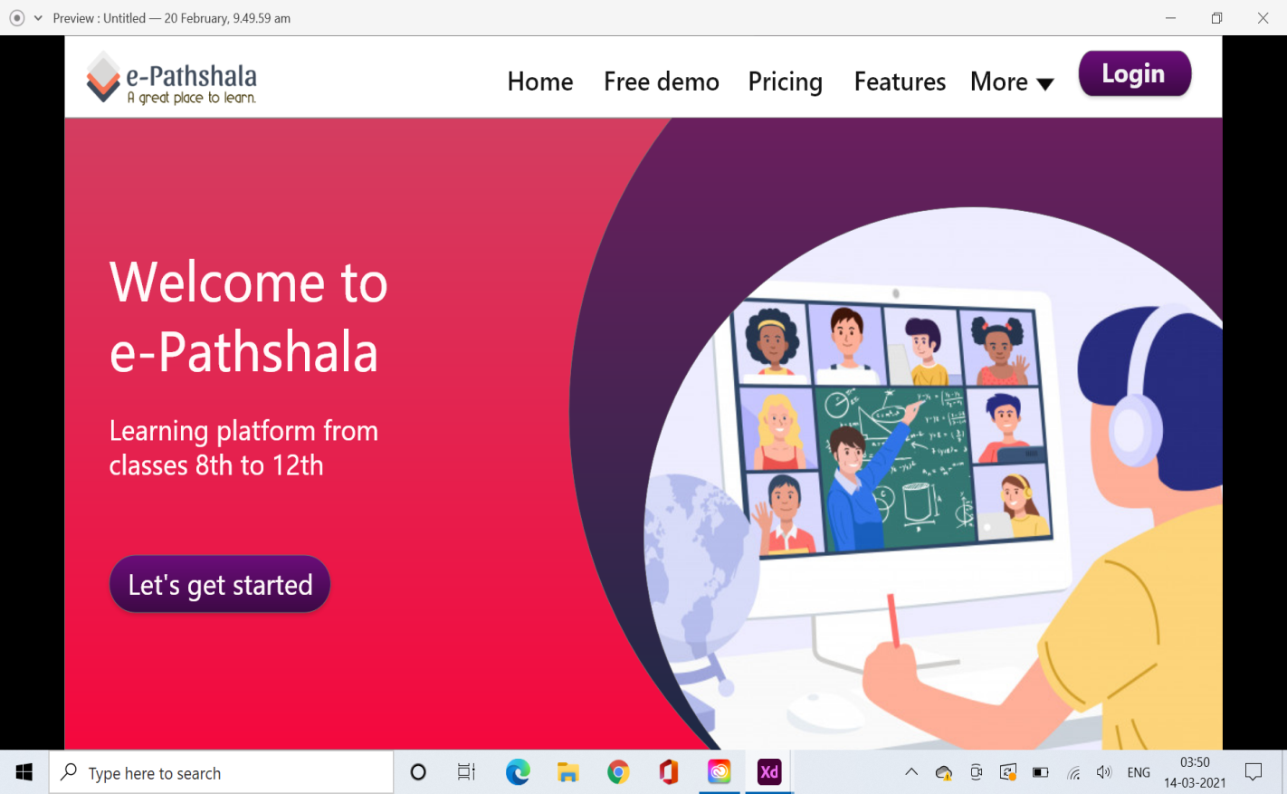
e-Pathshala

Slide 4
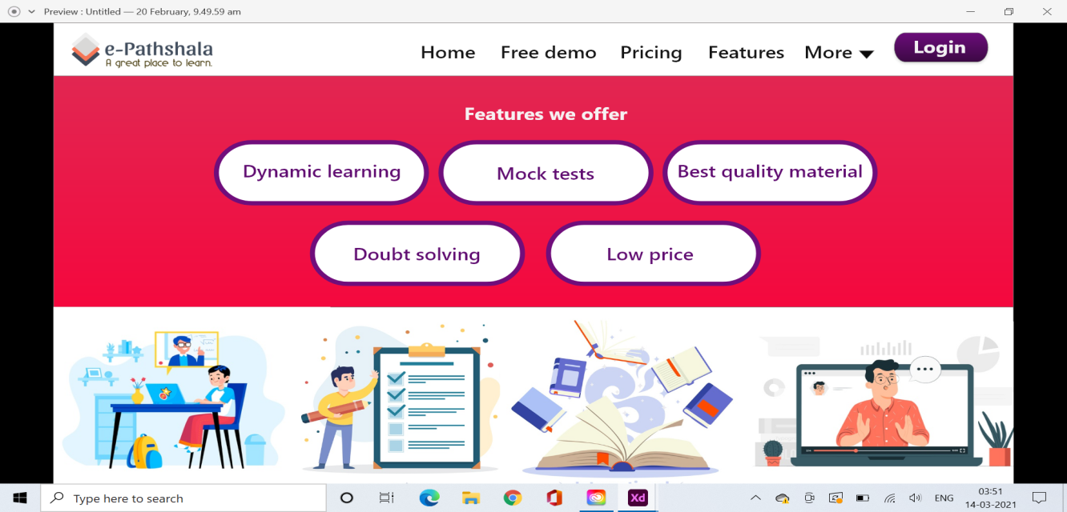
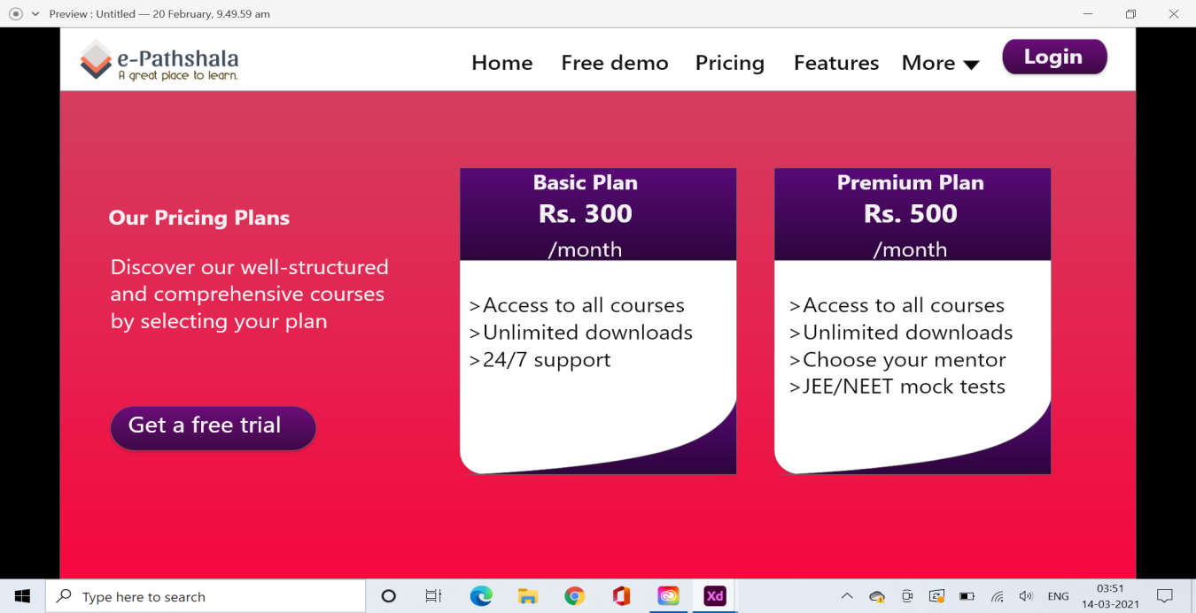
Amazing UI

Slide 5
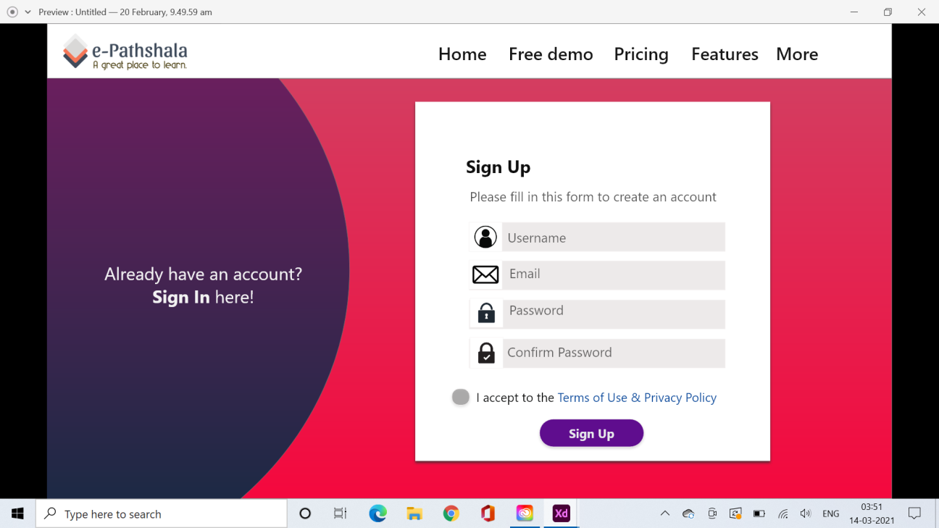
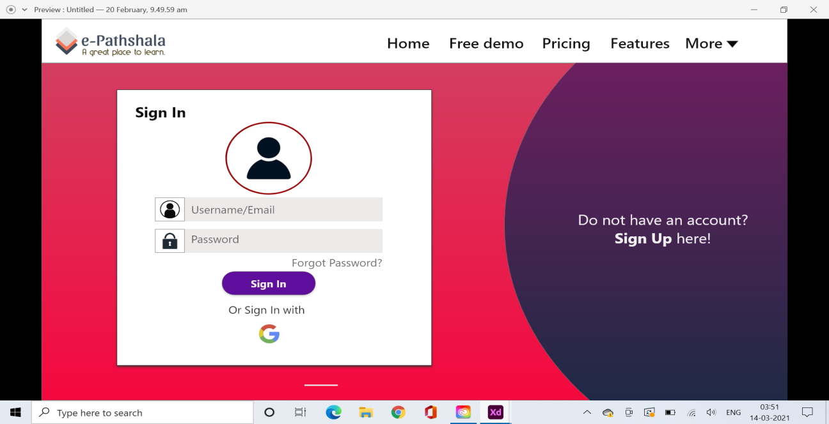
Get Started

Slide 6
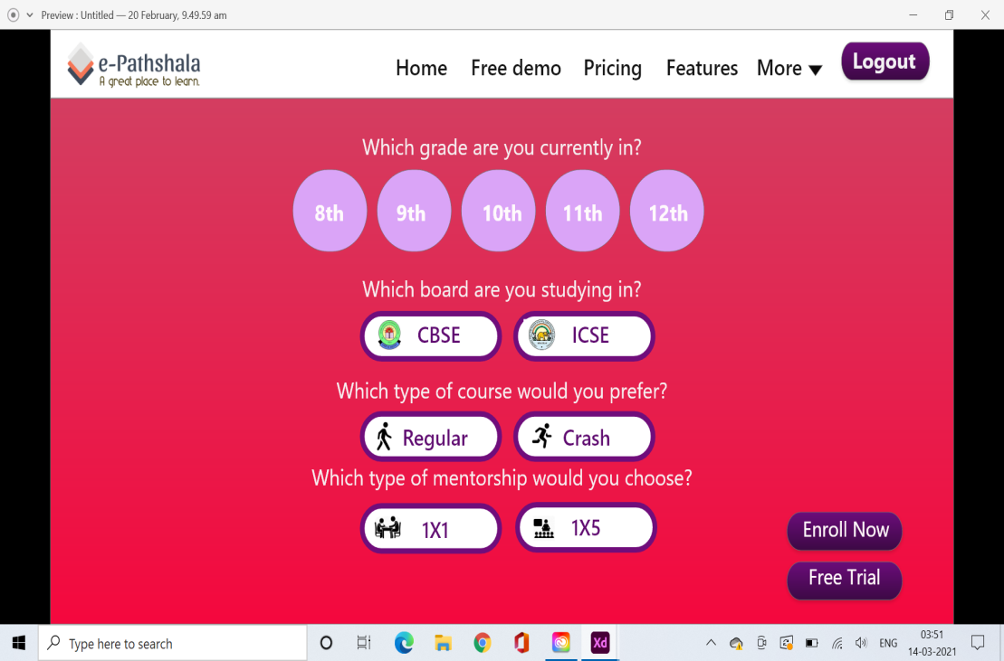

FUNCTIONALITIES

Slide 7
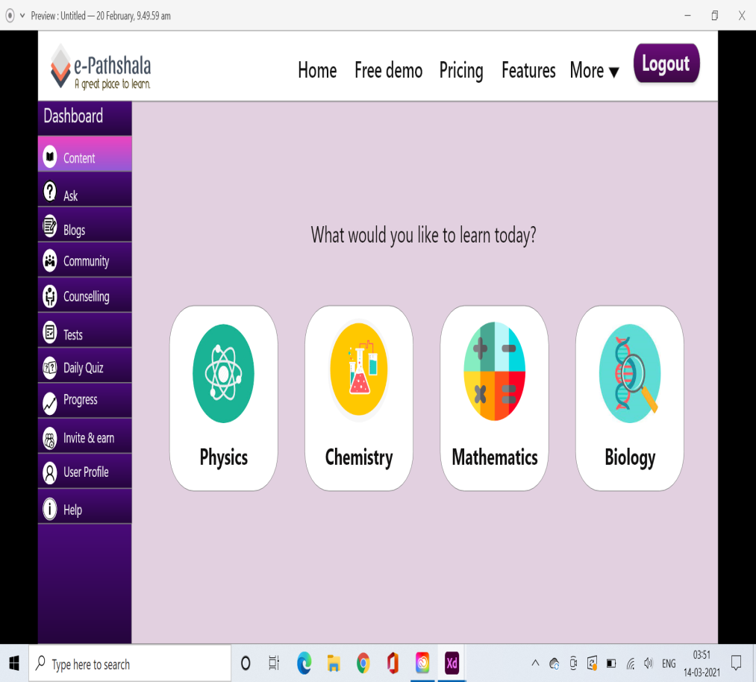
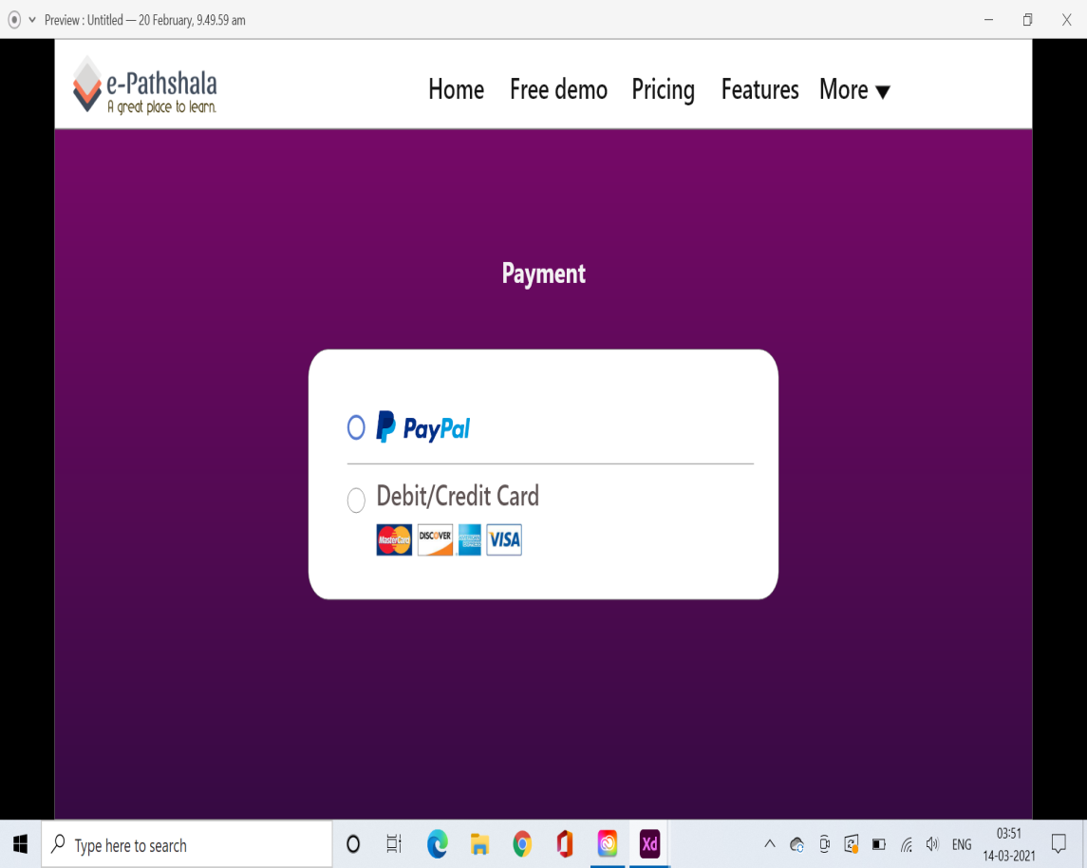
SELECT YOUR CHOICE!

Slide 8
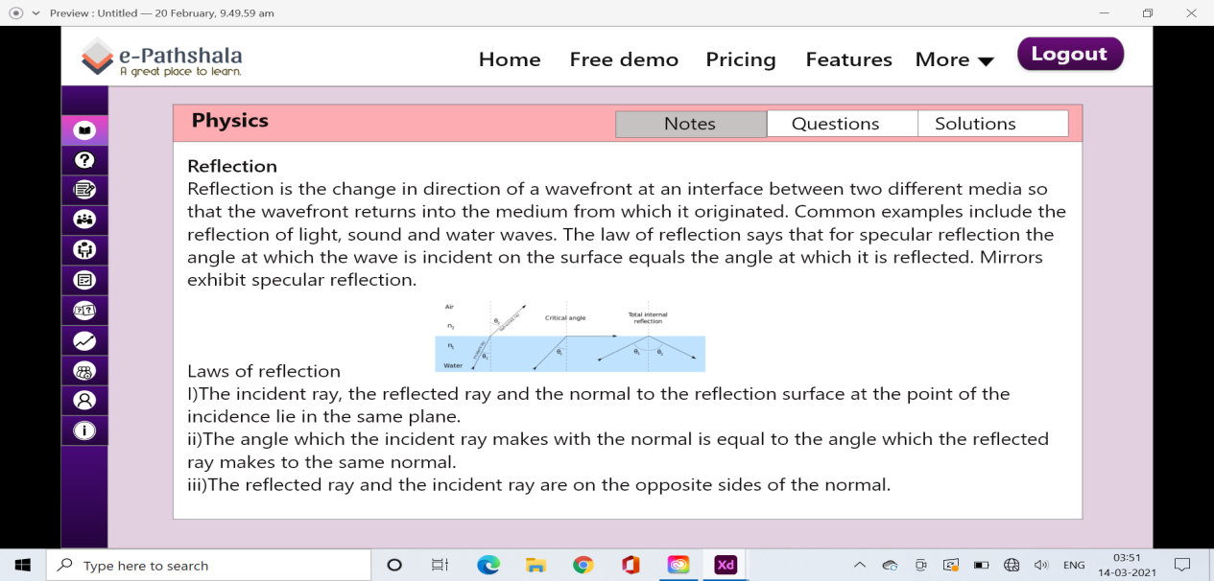
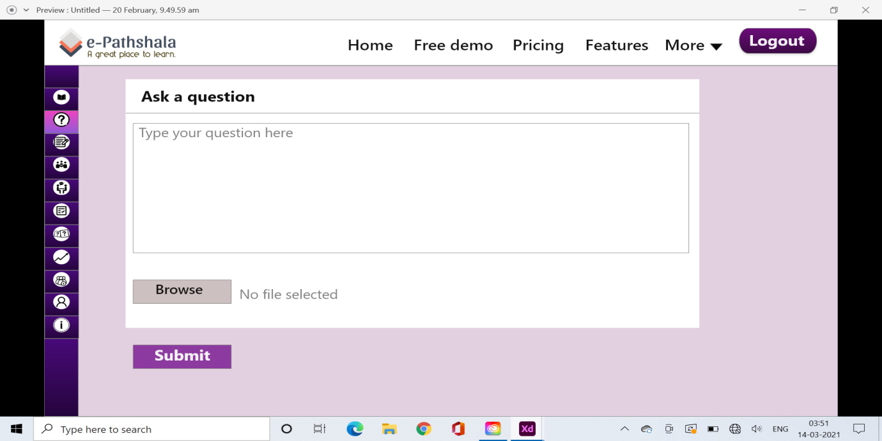
More to it!

Slide 9
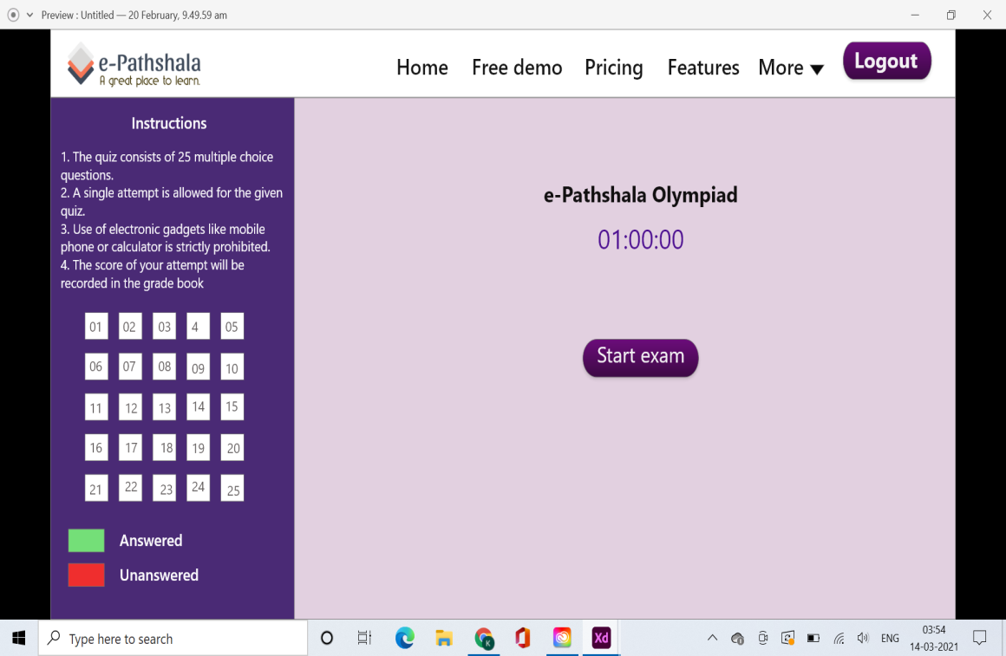
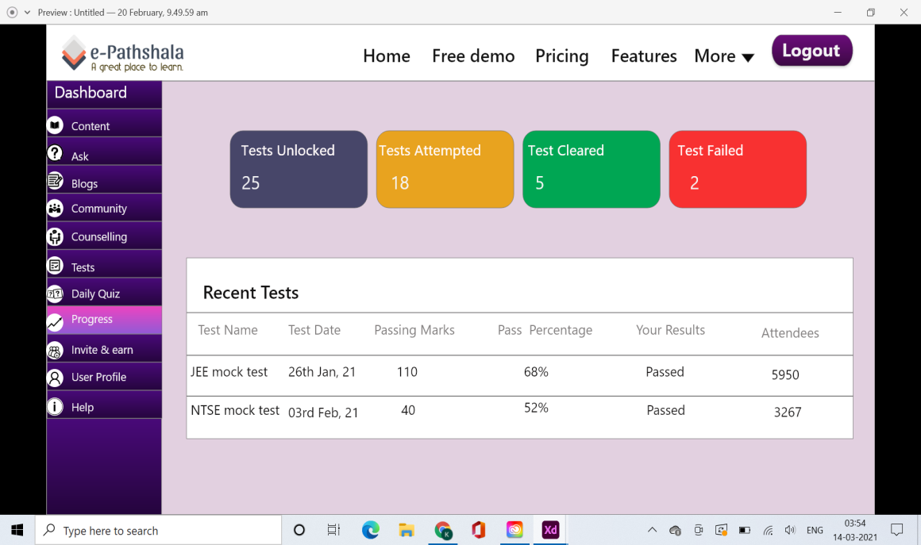
TEST YOURSELF

Slide 10

That’s it !

